Slide 1
Software Project Planning

Slide 2
After the finalization of SRS, we would like to estimate size, cost and development time of the project.
In many cases, customer may like to know the cost and development time even prior to finalization of the SRS.
An Essential issue in the planning process
being able to make plans that accurately represent what we do

Slide 3
Business operates on commitments, and commitments require plans.
The failure of many large software projects in the 1960s and early 1970s highlighted this problem of poor planning.
The delivered software was late, unreliable, costed several times the original estimates and often exhibited poor performances.
These projects did not fail because managers or developers were incompetent.
The fault was in the approach of planning that was used.
Planning techniques derived from small-scale projects did not scale up to large systems development.

Slide 4
Software managers are responsible for planning and scheduling project development.
They supervise the work to ensure that it is carried out to the required standards.
They monitor progress to check that the development is on time and within budget.
The project planning must incorporate major issues like size and cost estimation, scheduling, project monitoring and reviews, personnel selection and evaluation, and risk management.

Slide 5
In order to conduct a successful software project, we must understand :
Scope of work to be done
The risk to be incurred
The resources required
The task to be accomplished
The cost to be expended
The schedule to be followed

Slide 6

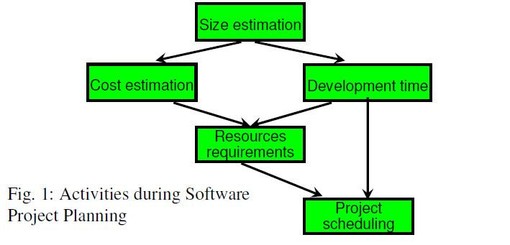
S

Slide 7
Size Estimation
The estimation of size is very critical and difficult area of the project planning.
Lines of Code(LOC)
It has the advantage of being easily recognizable, seen and therefore counted.
There is no general agreement about what constitutes a line of code.
Early users of lines of code did not include data declarations, comments or any other lines that did not result in object code.
Later users decided to include declarations and other unexecutable statements but still excluded comments and blank lines.

Slide 8
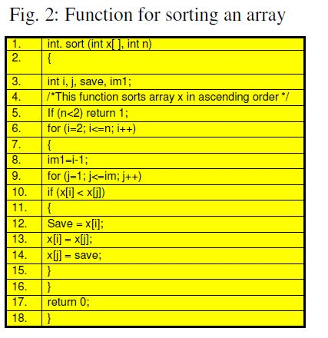
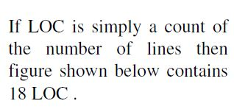
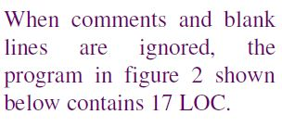
W
s

Slide 9
Most researchers agree that LOC metric should not include comments or blank lines.
Since they are internal documentation and their presence or absence does not affect the functions of the program.
The inclusion of comments and blank lines in the count may encourage developers to introduce artificially many such lines In project development in order to create the illusion of high productivity, which normally measured in LOC/PM(lines of code/person-month).

Slide 10
However, there is a fundamental reason for including comments in the program.
The quality of comments materially affects maintenance costs because maintenance person will depend on the comments more than anything else to do the job.
Conversely, too many blank lines and comments with poor readability and understandability will increase maintenance.
The problem with including comments is that we must be able to distinguish between useful and useless comments, and there is no rigorous way to do that.
Therefore, it is always advisable not to consider comments and blank lines while counting for LOC.

Slide 11
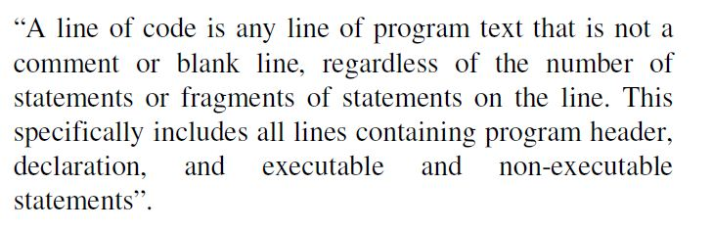
Conte has defined lines of code as

Slide 12
This is the predominant definition for lines of code used by researchers. By this definition the fig 2 has 17 LOC.
While lines of code have their uses( e.g., in estimating programming time for a program during the build phase of a project), their usefulness is limited for other tasks like functionality, complexity, efficiency, etc.

Slide 13
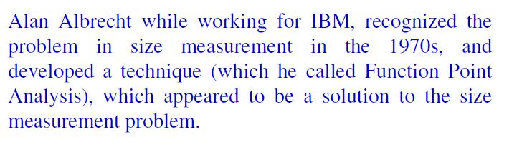
2. Function Count
e
It measures functionality from the users point of view, that is, on the basis of what the user requests and receives in return.
Therefore, it deals with the functionality being delivered, and not with the lines of code, source modules, files, etc.
Measuring size in this way has the advantage that size measure is independent of the technology used to deliver the functions.

Slide 14
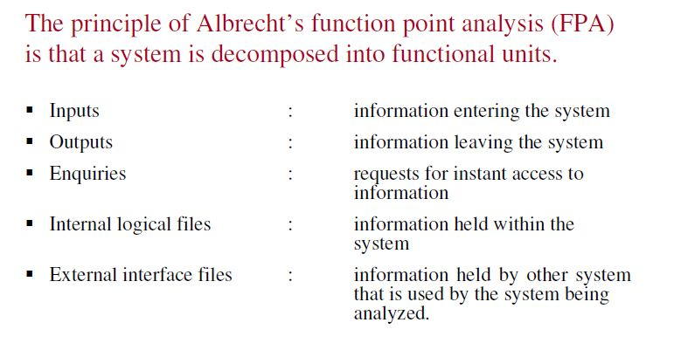

Slide 15
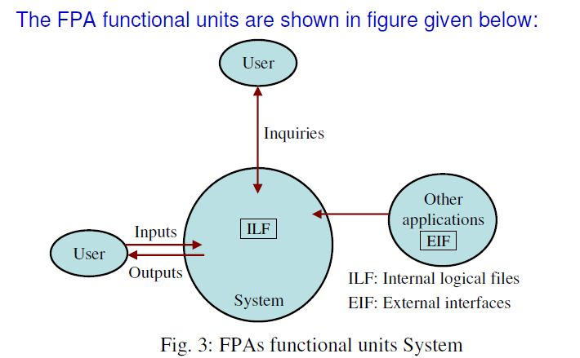

Slide 16
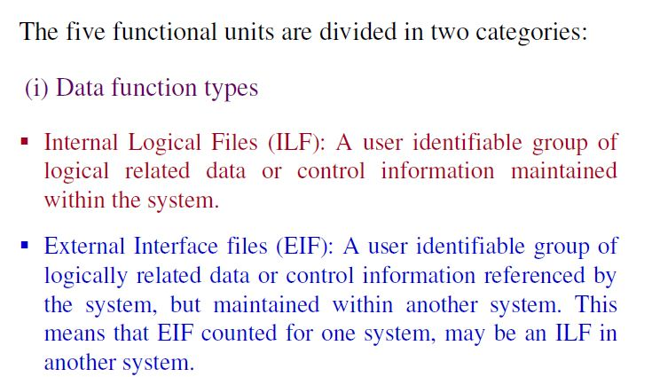

Slide 17
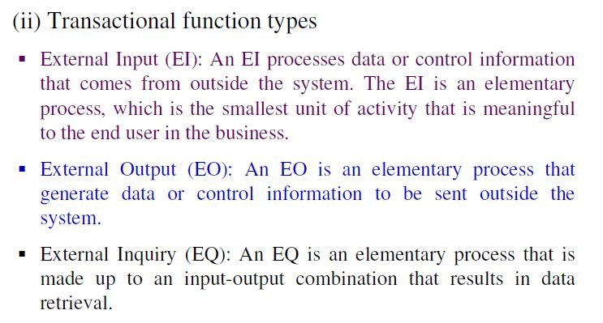

Slide 18
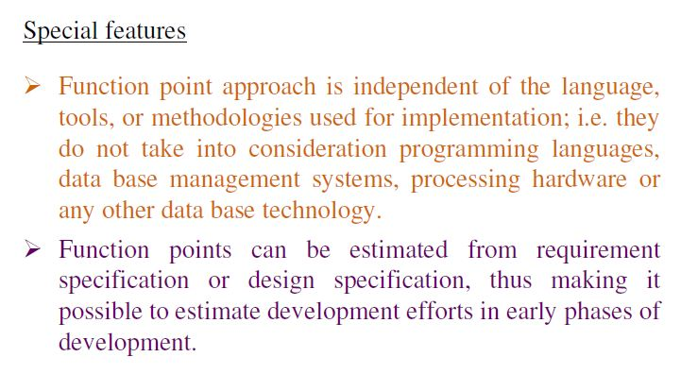
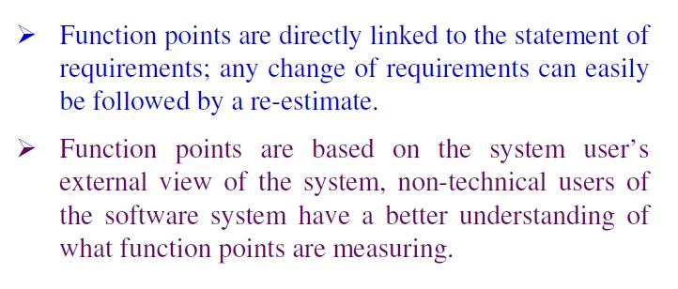

Slide 19
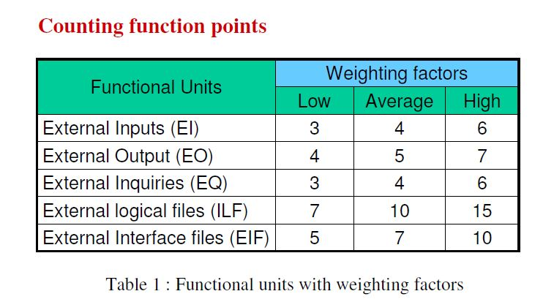

Slide 20
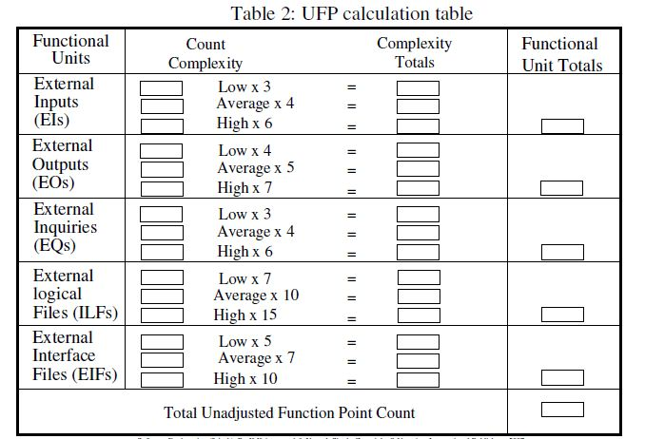
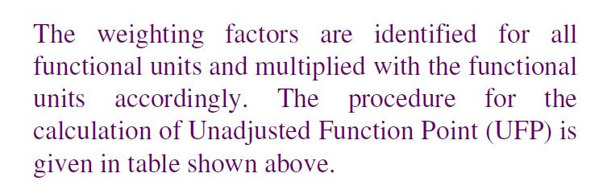

Slide 21
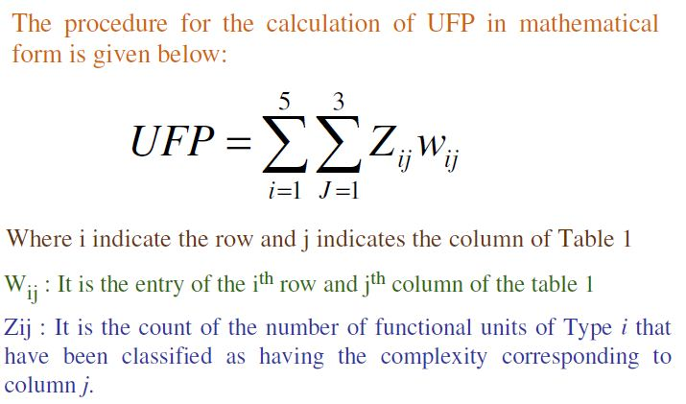

Slide 22
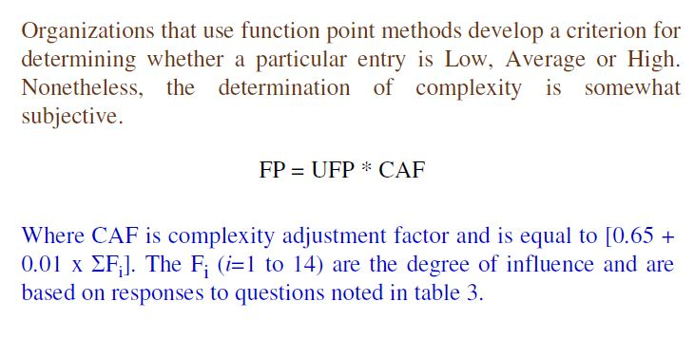

Slide 23
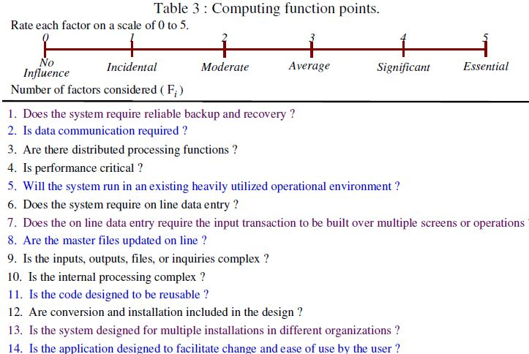

Slide 24
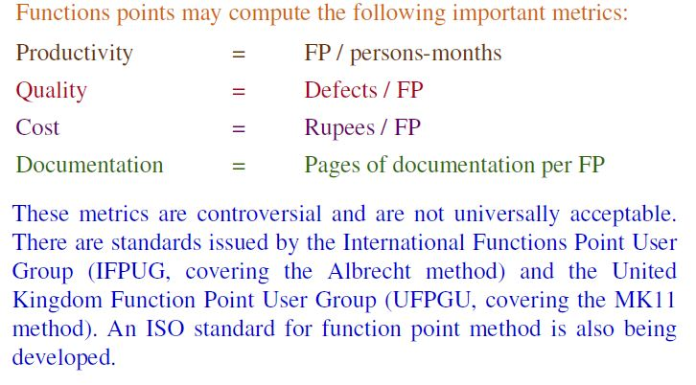

Slide 25
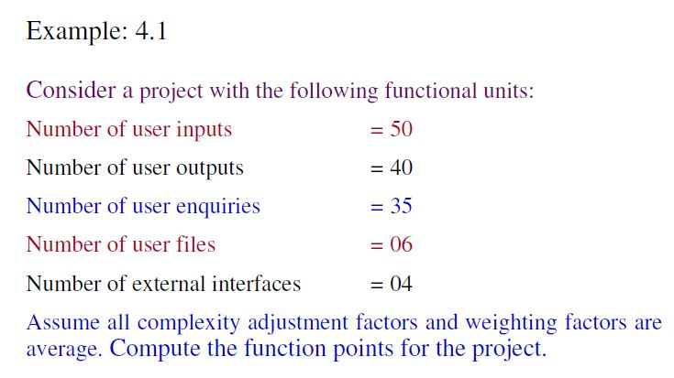

Slide 26
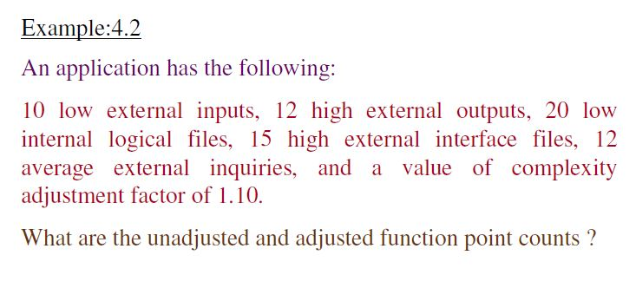

Slide 27
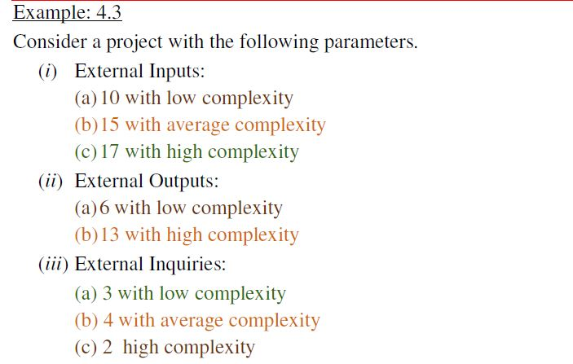

Slide 28
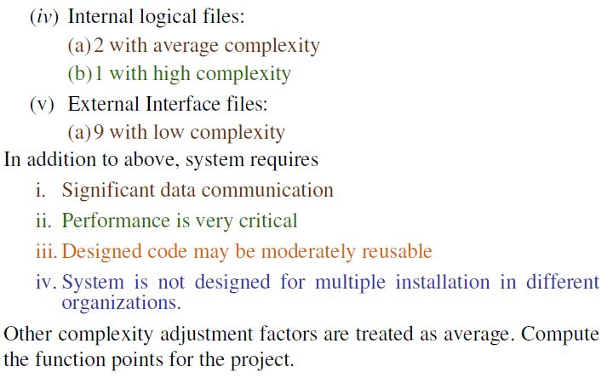

Slide 29
Project Estimation techniques
The different parameters of a project that need to be estimated include—project size, effort required to complete the project, project duration, and cost.
A large number of estimation techniques have been
proposed by researchers.
These can broadly be classified into three main categories:
Empirical estimation techniques
Heuristic techniques
Analytical estimation techniques

Slide 30
Empirical estimation techniques
Empirical estimation techniques are essentially based on making an educated guess of the project parameters.
While using this technique, prior experience with development of similar products is helpful.
Two formalisations of the basic empirical estimation techniques known as
Expert judgement and
the Delphi techniques

Slide 31
Expert judgement: It is a widely used size estimation technique.
In this technique, an expert makes an educated guess about the problem size after analyzing the problem thoroughly.
Delphi cost estimation technique tries to overcome some of the shortcomings of the expert judgement approach. Delphi estimation is carried out by a team comprising a group of experts and a co-ordinator.
In this approach, the co-ordinator provides each estimator with a copy of the software requirements specification (SRS) document and a form for recording his cost estimate.

Slide 32
Heurestic Techniques:
Heurestic techniques assume that the relationships that exist among the different project parameters can be satisfactorily modelled using suitable mathematical expressions.
Once the basic(independent) parameters are known, the other(dependent) parameters can be easily determined by substituting the values of the independent parameters in the corresponding mathematical expression.

Slide 33
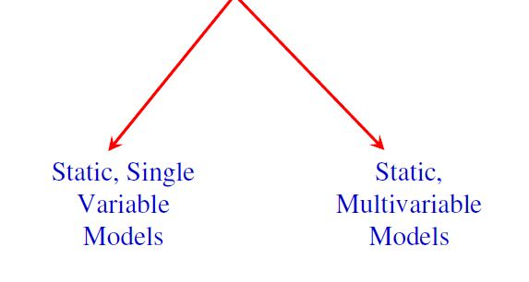
Models
The variables, single or multivariable, that are input to the model to predict the behavior of a software development are called predictors.

Slide 34
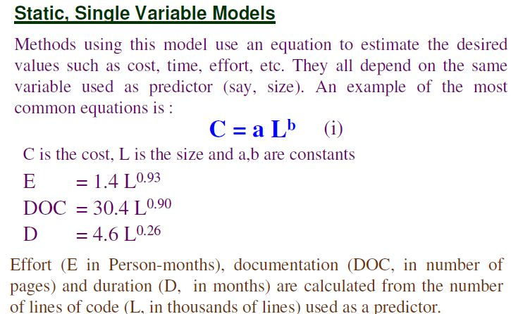
The above equations are from SEL model established by the Software Engineering Laboratory of the University of Maryland for estimating its own software productions.
This model is a typical example of a static single-variable model.

Slide 35
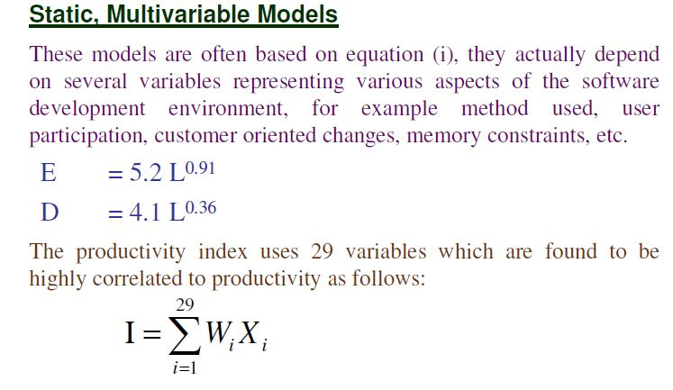
Where, wi is a factor weight for the ith variable and Xi={-1,0,+1}.
The estimator gives Xi one of the values -1,0 or+1 depending on whether the variable decreases, has no effect, or increases the productivity respectively.
The terms of the equation are then added to give the productivity index.
The above equation is used in the model developed by Watson and Felix.

Slide 36
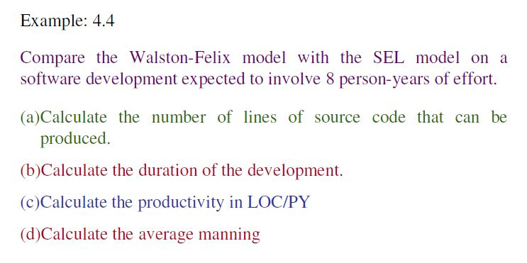

Slide 37
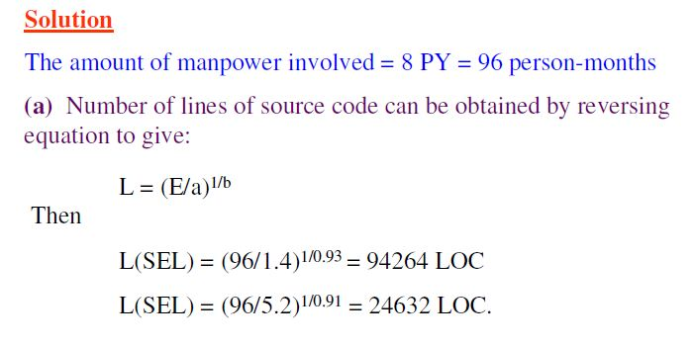

Slide 38
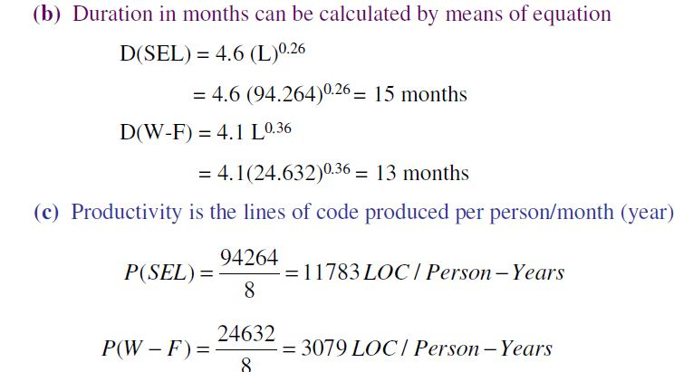

Slide 39
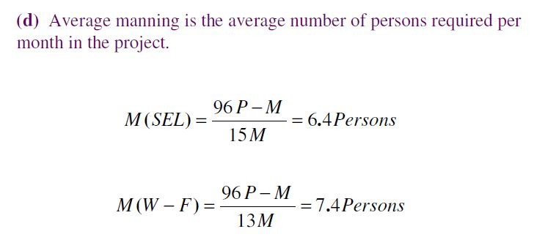

Slide 40
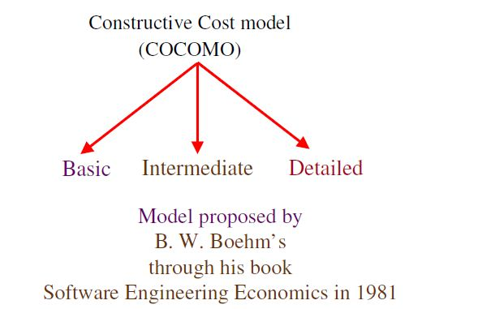
The Constructive cost model(Cocomo)- A Heurestic estimation technique
COCOMO is a hierarchy of software estimation models which include basic, intermediate and detailed sub models.
Notes:
A multivariable estimation model.

Slide 41
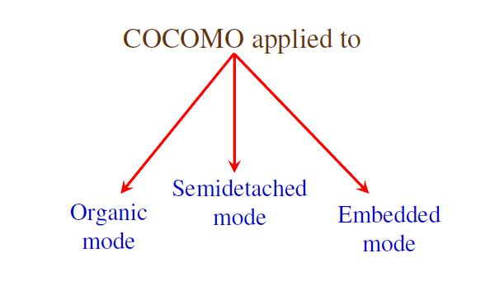

Slide 42
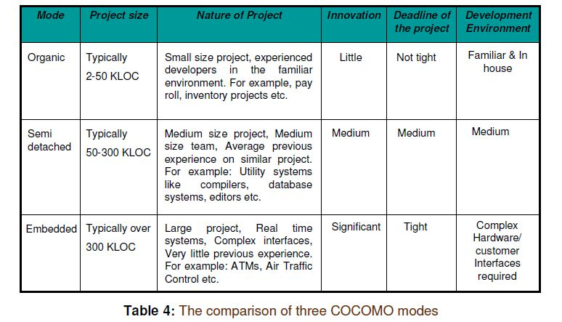

Slide 43
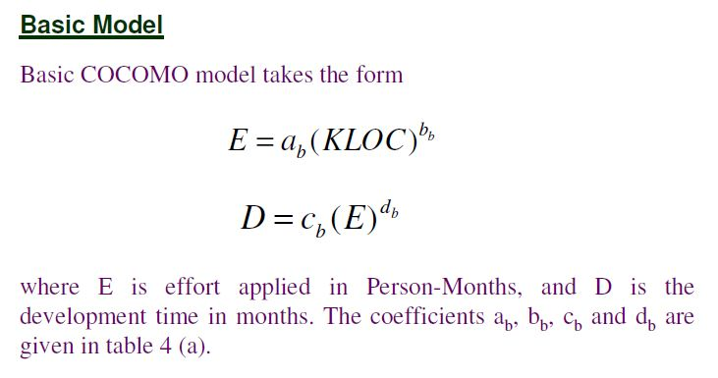
The basic model aims at estimating, in a quick and rough fashion, most of the small to medium sized projects.

Slide 44
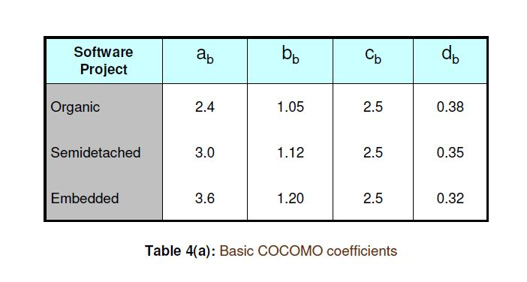

Slide 45
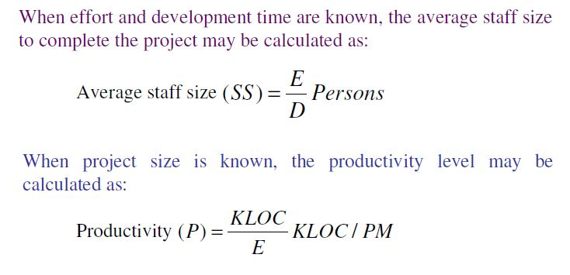

Slide 46
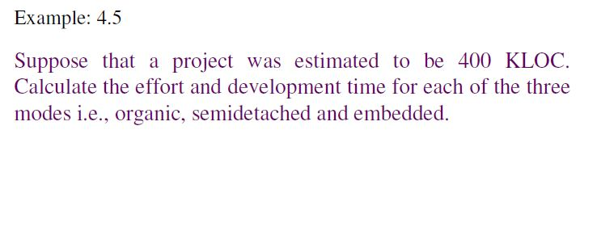

Slide 47
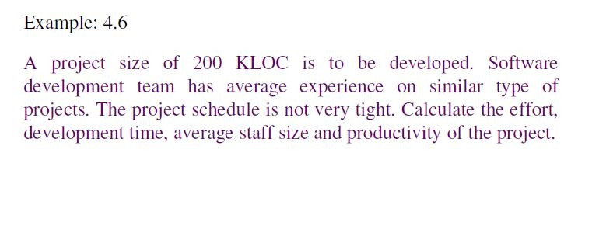

Slide 48
The basic model allowed for a quick and rough estimate, but it resulted in a lack of accuracy.
Boehm introduced an additional set of 15 predictors called cost drivers in the intermediate model to take account of the software development environment.
Cost drivers are used to adjust the nominal cost of the actual project environment, hence increasing the accuracy of the estimate.

Slide 49
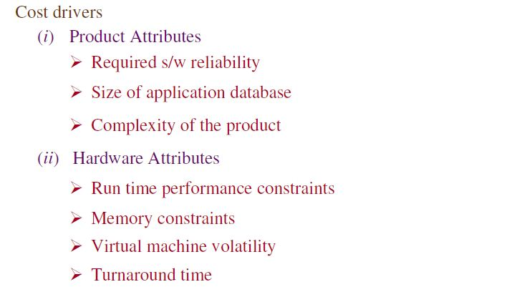
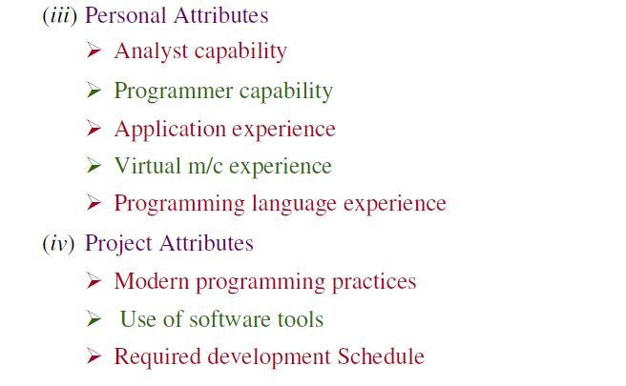
(RELY)
(DATA)
(CPLX)
(TIME)
(STOR)
(VIRT)
(TURN)
(ACAP)
(AEXP)
(PCAP)
(VEXP)
(LEXP)
(MODP)
(TOOL)
(SCED)

Slide 50
Each cost driver is rated for a given environment.
The rating uses a scale very low, low, nominal, high, extra high which describes to what extent the cost driver applies to the project being estimated.
The multiplying factors for all 15 cost drivers are multiplied to get the effort adjustment factor(EAF). Typical values for EAF range from 0.9 to 1.4

Slide 51
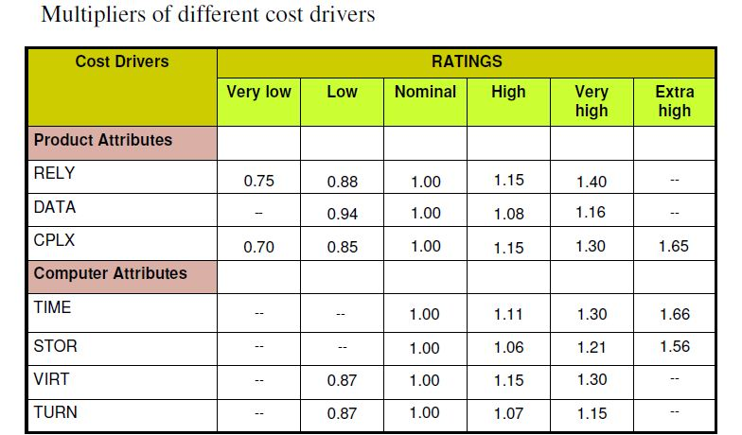

Slide 52
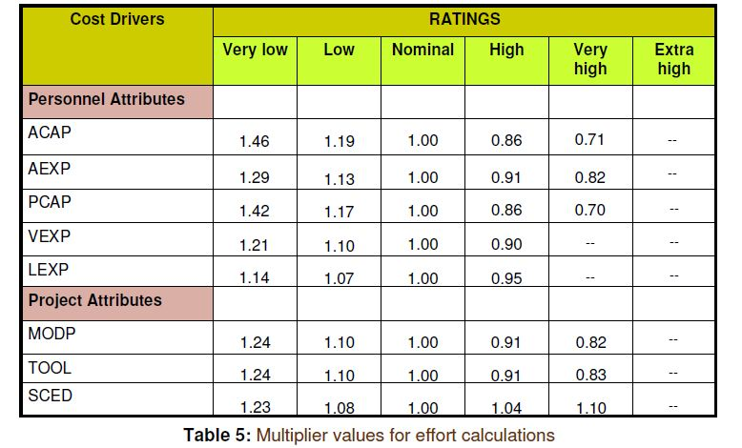

Slide 53
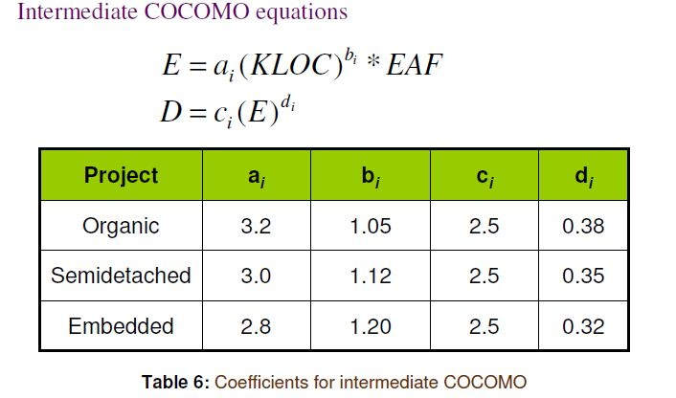

Slide 54
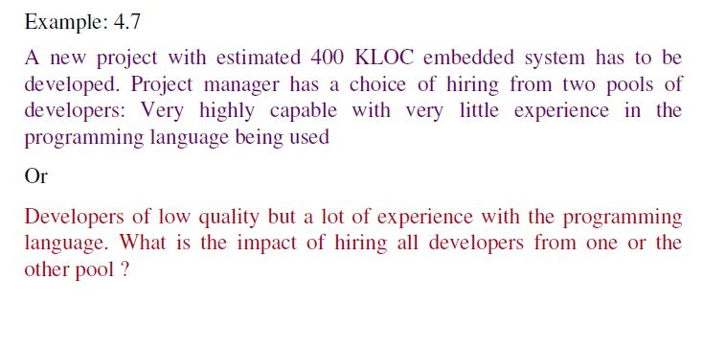

Slide 55
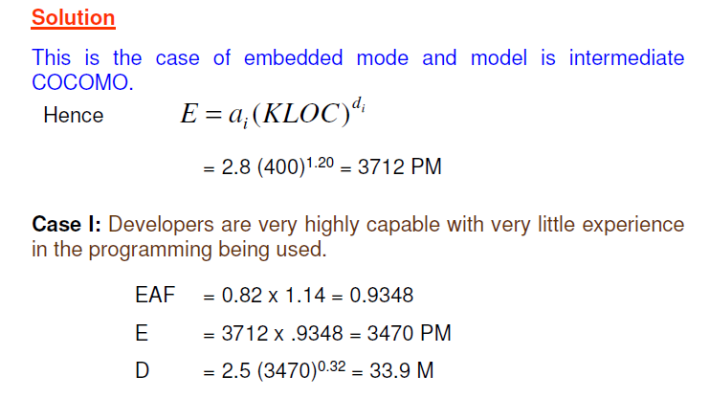

Slide 56
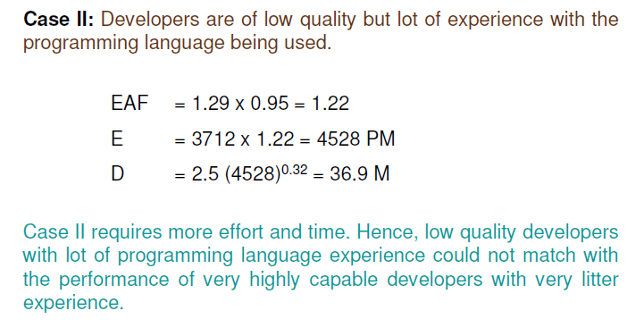

Slide 57

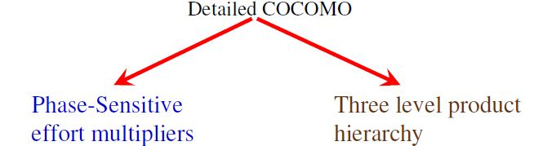
It offers a means for processing all the project characteristics to construct a software estimate.
The detailed model introduces two more estimates:

Slide 58
Phase-sensitive effort multipliers: Some phases(design, programming, integration/test) are more affected than others by the cost drivers.
The detailed model provides a set of phase sensitive effort multipliers for each cost driver. This helps in determining the manpower allocation for each phase of the project.
Three-level product hierarchy: Three product levels are defined.
There are module, subsystem and system levels.
The ratings of the cost drivers are done at appropriate level; that is, the level at which it is more susceptible to variation.

Slide 59
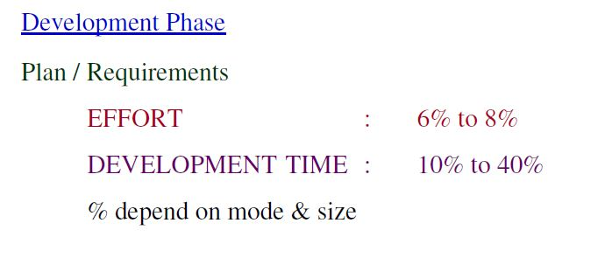
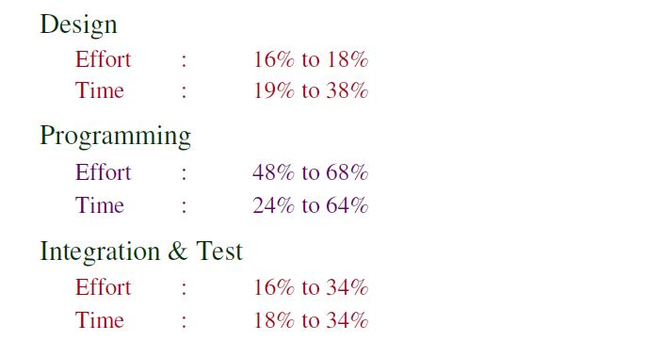

Slide 60
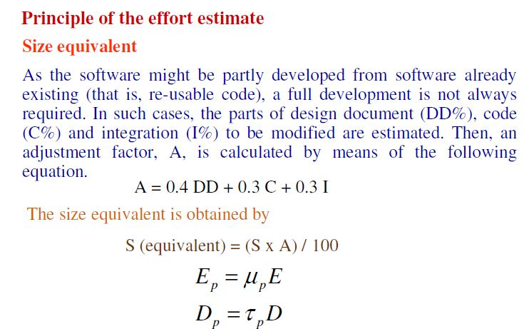
S represents the thousands lines of code(KLOC) of the module.
Ep and Dp gives the overall effort and schehedule.
µ_{p} and _{p} are the multipliers developed that can be applied to effort and development respectively

Slide 61


Slide 62


Slide 63


Slide 64


Slide 65


Slide 66


Slide 67


Slide 68


Slide 69


Slide 70
Putnam observed that the rayleigh curve was a close representation, not only at the project level but also for software subsystem development.
The curve specifies the relationship between applied effort and delivery time for a software project.
As many as 150 projects were studied by Norden and subsequently by Putnam, and apparently both researchers observed the same tendency for the manpower curve to raise, and then exponentially trail off as a function of time.

Slide 71


Slide 72


Slide 73

By deriving the manpower function relative to time and finding the zero value of this derivative, the relationship between the peak time, “td”, and “a” can be found to be:
E is the estimate for development time

Slide 74

The peak manning time is related to “a”. Therefore, “a” can be obtained from the peak time as follows:

Slide 75


Slide 76


Slide 77

The average rate of software team build-up can also be calculated by dividing mo by td.

Slide 78


Slide 79


Slide 80


Slide 81


Slide 82


